Slide 1
Advanced Class Modelling
Abstract Classes
Multiple Inheritance
Metadata
Reification
Constraints
Derived Data
Packages

Slide 2
Abstract Classes
Abstraction = Omitting Details
Incomplete class definitions
Unimplemented methods are implemented in the subclasses.
Notes:
An abstract class contains abstract methods

Slide 3
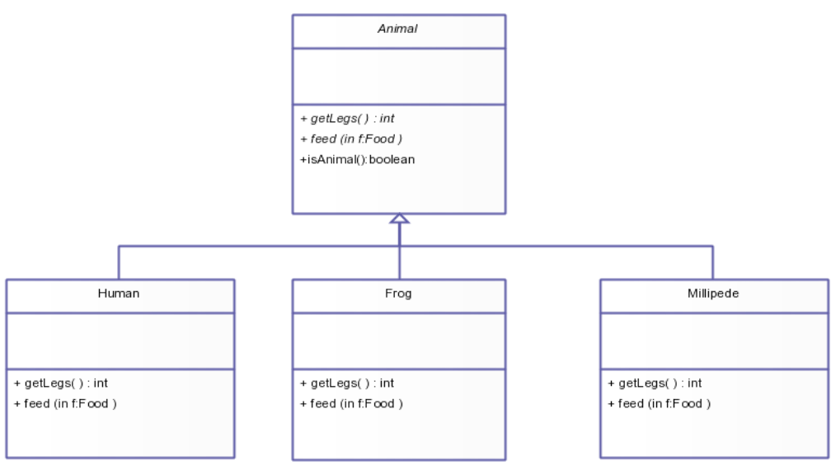

Slide 4
Analogies
View from far (Abstract Class). View from up close (Concrete Class)
CupOfCoffee
Sockets(Abstract Classes) and Plugs(Concrete Classes)
Notes:
Ex: Usb Port, USB Device

Slide 5





Slide 6
Multiple Inheritance
object or class can inherit characteristics and features from more than one parent object or parent class
<object> is a <super class> and is a <super class> and is a <super class>.......

Slide 7
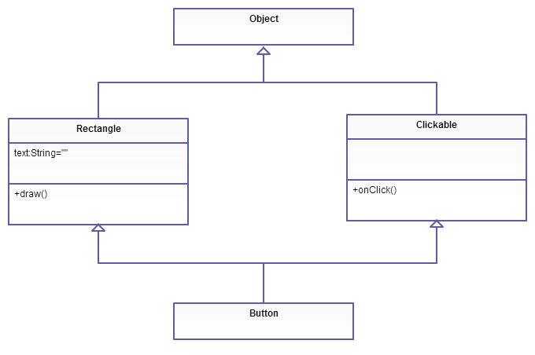

Slide 8
Criticisms
Semantic ambiguity
Class Confusion
Increase in complexity
Lack of proper language support

Slide 9
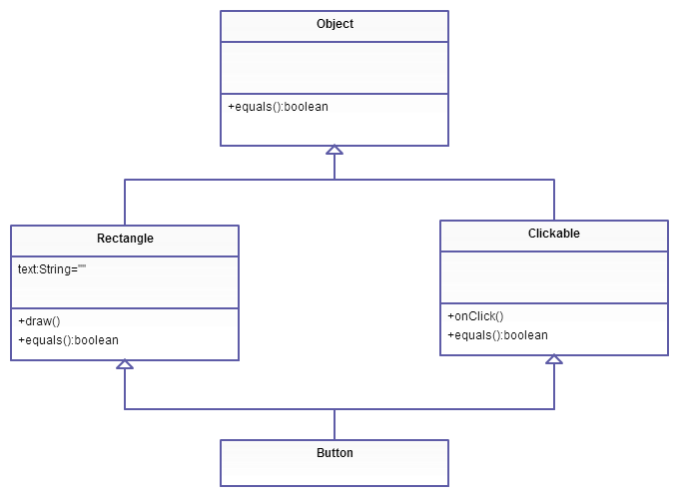
Diamond of Death!

Slide 10
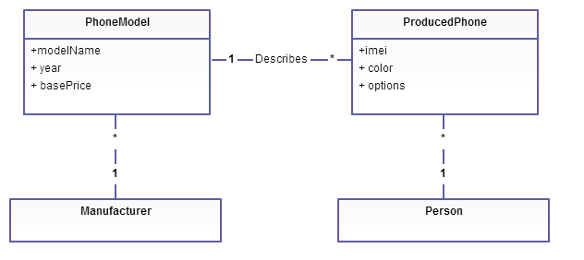
Metadata
Data that describe other data.
Ex: Models, Blueprints, Dictionaries, Computer Languages

Slide 11
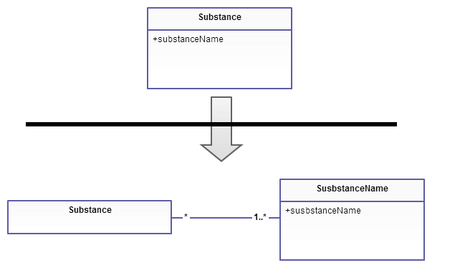
Reification
Promotion of non object to objects
Why?
Helps shift the levels of Abstraction
Semantic clarity

Slide 12
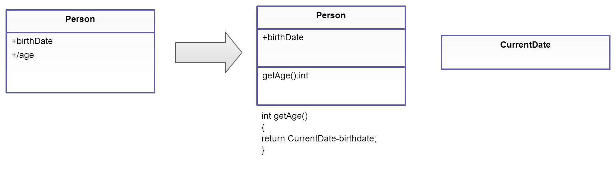
Derived Data
Derived element is a function of one or more elements.
Redundant and must be avoided.

Slide 13
Constraints
Constraints on Objects
Constraints on Generalization Sets
Disjoint/Overlapping
Complete/Incomplete
Constraints on Links
Using Constraints
Braces/Dogeared

Slide 14
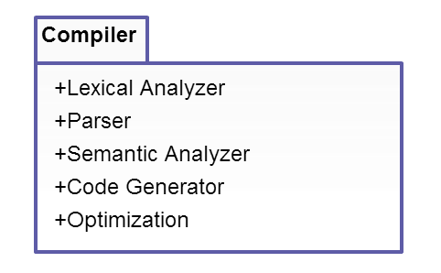
Packages
Group of elements of a common theme
Elements (classes, associations, generalizations and lesser packages)
Divides large problems into easily understandable modules

Slide 15
Fin

